Slide 1
Lecture 3: Circuit Partitioning – I
Tsung-Wei (TW) Huang
Department of Electrical and Computer Engineering
University of Utah, Salt Lake City, UT

Slide 2
Physical Design Flow

Slide 3
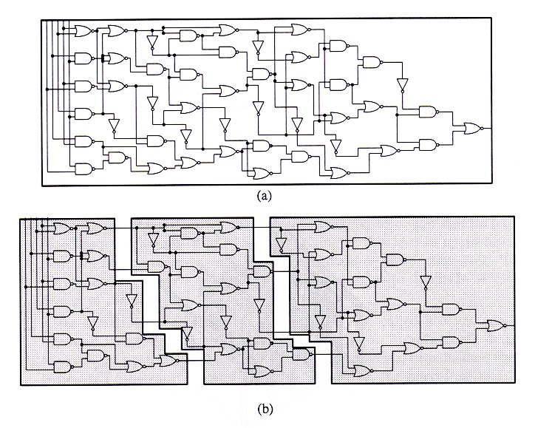
Circuit Partition
An essential step for reducing algorithm design complexity
Divide and conquer (D&C)
Input
A circuit graph
Output
A set of partitioned subgraphs
Objective
Minimize cross-connection

Slide 4
Importance of Circuit Partition
Divide & Conquer design methodology
The most effective way to solve problems of high complexity
Ex: min-cut based placement, partitioning-based test generation, …
System-level partitioning for multi-chip designs
Inter-chip interconnection delay dominates system performance
Circuit emulation/parallel simulation
Partition large circuit into multiple FPGAs or multiple special-purpose processors
Parallel CAD development
Task decomposition and load balancing
In deep-submicron designs, partitioning defines local and global interconnect, and has significant impact on circuit performance

Slide 5
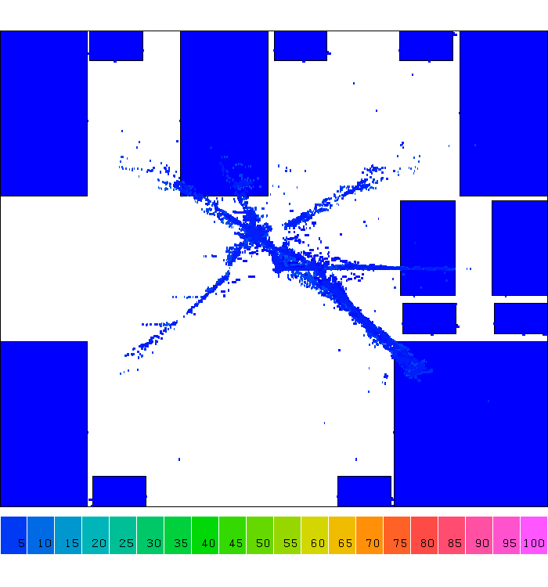
Application: D&C-based Placement
Notes:
Let's take a look at one step of computer design, placement. A placement is a step that tries to find the location of each gate, you know Or gate, NAND gate, NOT gate, and other gates, in a chip area. And we have billions of gate to place in a finger size chip.
Computer design tools don't do this. They do this in divide and conquer. (explain)

Slide 6
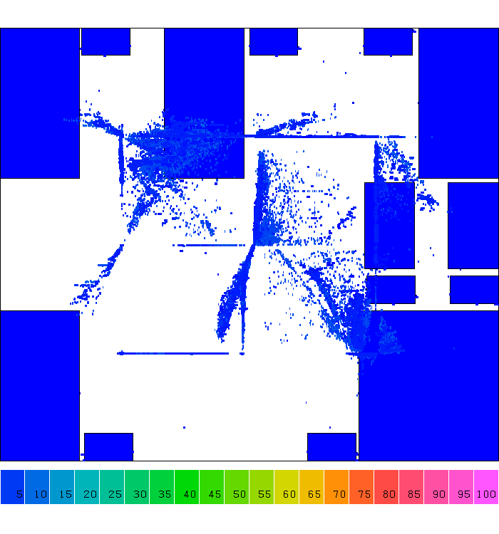
Application: D&C-based Placement

Slide 7
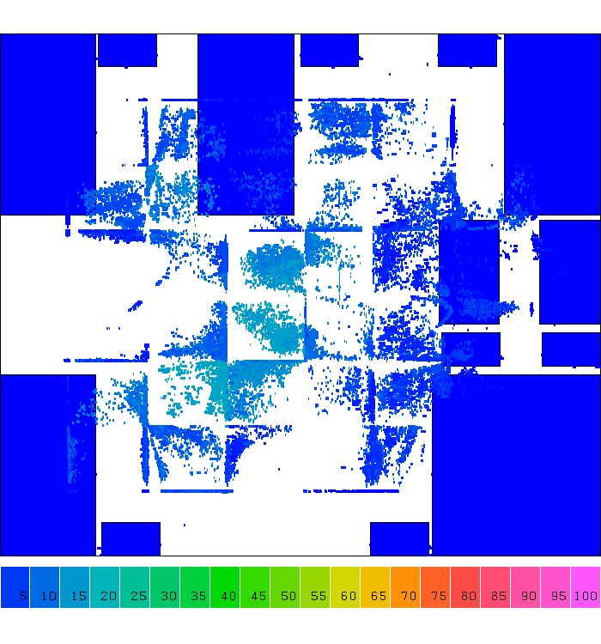
Application: D&C-based Placement

Slide 8
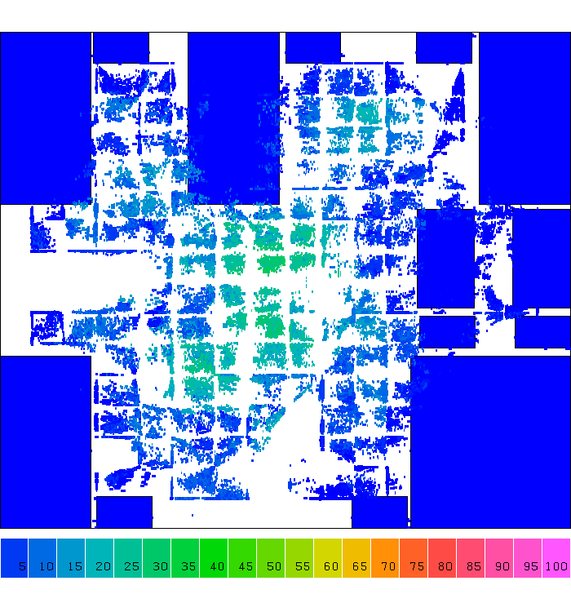
Application: D&C-based Placement

Slide 9
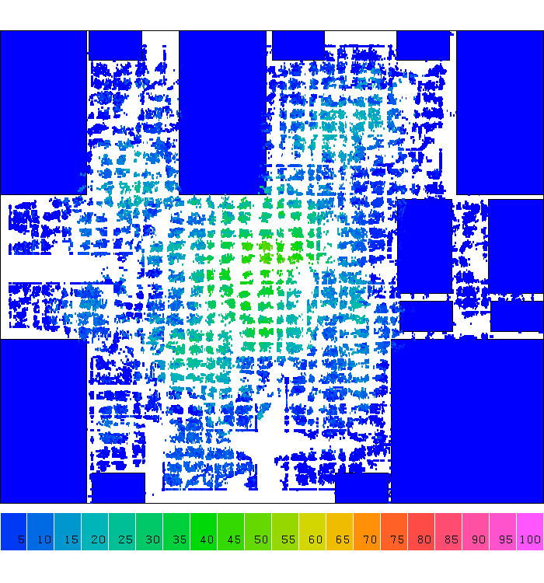
Application: D&C-based Placement

Slide 10
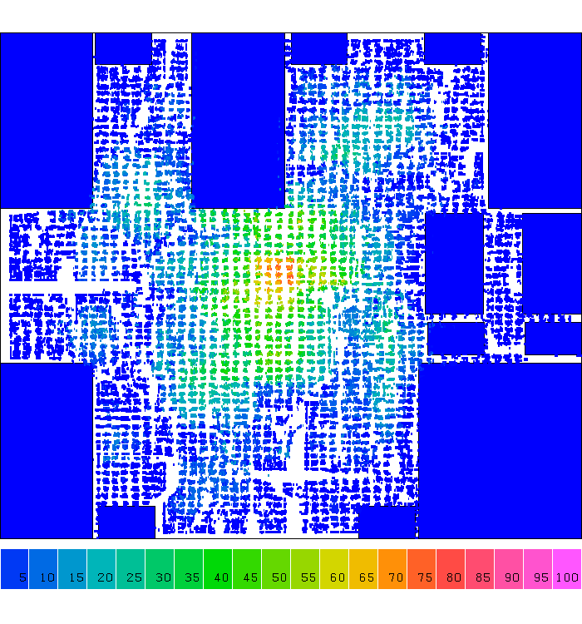
Application: D&C-based Placement

Slide 11
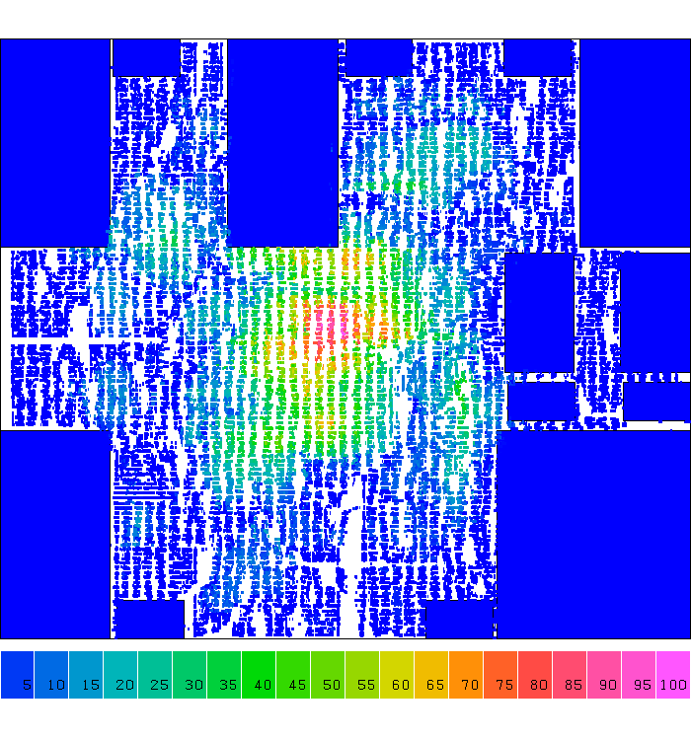
Application: D&C-based Placement

Slide 12
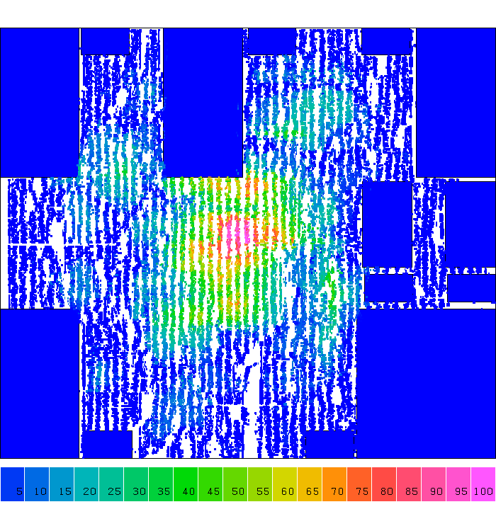
Application: D&C-based Placement
Notes:
So, from iteration to iteration you can clearly see cells are placed very regularly, right, Cells are spreading along the 2D grid partition. We partition the large chip care into smaller grids and place cells in those small grids. Solving the smaller grid problem is definitely more efficiently than directly handling the original problem.

Slide 13
Terminology
Partitioning
Dividing bigger circuits into a small number of partitions (top down)
Clustering
Cluster small cells into bigger clusters (bottom up)
Covering / Technology Mapping
Clustering such that each partition (cluster) has special structure
k-way Partitioning
Dividing into k partitions
Bipartitioning
2-way partitioning
Bisectioning
Bipartitioning such that the two partitions have the same size

Slide 14
Circuit Representation
Netlist
Gates: A, B, C, D
Nets: {A,B,C}, {B,D}, {C,D}
Hypergraph
Vertices: A, B, C, D
Hyperedges: {A,B,C}, {B,D}, {C,D}
Vertex label: Gate size/area
Hyperedge label:
Importance of net (weight)
B
A
C
D
B
A
C
D

Slide 15
Circuit Partition Formulation
Minimize interconnections between partitions
c(X,X’)
X
X’
Minimum cut: min c(x, x’)
Minimum bisection: min c(x, x’) with |x|= |x’|
Minimum ratio-cut: min c(x, x’) / |x||x’|

Slide 16
A Bi-partitioning Example
a
c
100
e
100
100
100
100
min-cut
9
4
b
10
d
100
f
Ratio-cut helps to identify natural clusters!
mini-ratio-cut
min-bisection
Min-cut:
Min-bisection cut:
Min-ratio-cut:
cut size = 13
cut size = 300
cut size = 19

Slide 17
Circuit Partition Formulation
General multi-way partitioning formulation
Partition a network N into N₁, N₂, …, N_{k} such that
Each partition has an area constraint
Each partition has an I/O constraint
Minimize the total interconnection:
∑
a
(
v
)
≤
A
i
v
∈
N
i
c
(
N
,
N
−
N
)
≤
I
i
i
i
∑
−
c
(
N
,
N
N
)
3-way partitions (k=3)
i
i
N
i

Slide 18
Circuit Partitioning Algorithms
Iterative partitioning algorithms
Spectral based partitioning algorithms
Deterministic vs. probabilistic algorithms
Net partitioning vs. module partitioning
Multi-way partitioning
Multi-level partitioning
Further study in partitioning techniques (timing-driven …)

Slide 19
Iterative Partitioning Algorithms
Greedy iterative improvement method
[Kernighan-Lin 1970]
[Fiduccia-Mattheyses 1982]
[Krishnamurthy 1984]
…
Simulated Annealing
[Kirkpartrick-Gelatt-Vecchi 1983]
[Greene-Supowit 1984]
…

Slide 20
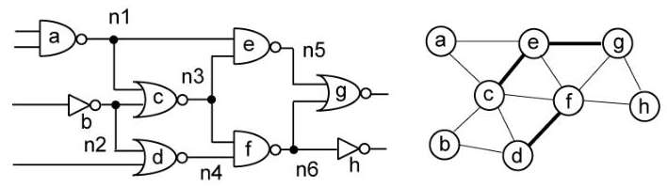
Kernighan-Lin (KL) Algorithm
“An Efficient Heuristic Procedure for Partitioning Graphs,” The Bell System Technical Journal, 49(2):291-307, 1970

Slide 21
Restricted Partition Problem
Restrictions
For Bisectioning of circuit (k=2, two-way partitioning)
Assume all gates are of the same size
Works only for 2-terminal nets
If all nets are 2-terminal, the hypergraph is called a graph
B
B
A
A
Hypergraph
Representation
Graph
Representation
C
D
C
D

Slide 22
Problem Formulation
Input: A graph with
Set vertices V (|V| = 2n)
Set of edges E (|E| = m)
Cost c_{AB} for each edge {A, B} in E
Output: 2 partitions X & Y such that
Total cost of edges cut is minimized
Each partition has n vertices
This problem has been proven to be NP-complete
Very difficult to find the optimal partition efficiently

Slide 23
A Naive Approach …
Try all possible bisections, find the best one
If there are 2n vertices,
# of possibilities =
For 4 vertices (A,B,C,D), 3 possibilities
1. X={A,B} & Y={C,D}
2. X={A,C} & Y={B,D}
3. X={A,D} & Y={B,C}
For 100 vertices, 5x10²⁸ possibilities
Need 1.59x10¹³ years if one can try 100M possibilities per second
= (2n)! / (2 × (n!²)) = n^{O(n)}

Slide 24
Idea of KL Algorithm
D_{A} = Decrease in cut value if moving A
External cost (connection) E_{A} – Internal cost I_{A}
Moving node a from block X to block Y would increase the value of the cutset by E_{A} and decrease it by I_{A}
X
B
Y
X
B
Y
C
C
= 2-1 = 1
= 1-1 = 0
D_{A} =
D_{B} =
A
D
A
D

Slide 25
Idea of KL Algorithm
Note that we want to balance two partitions
If switch A & B, gain(A,B) = D_{a} + D_{b}?
X
Y
X
B
Y
B
C
C
D
A
A
D
gain(A,B) = 1+0 = 1?

Slide 26
Idea of KL Algorithm
Note that we want to balance two partitions
If switch A & B, gain(A,B) = D_{A} + D_{B} – 2C_{AB}
c_{AB :} edge cost for AB
X
Y
X
B
Y
B
C
C
D
A
A
D
gain(A,B) = 1+0-2 = -1

Slide 27
KL Algorithm
Start with any initial legal partitions X and Y
A pass (exchanging each vertex exactly once) is described below:
1. For i := 1 to n do
From the unlocked (unexchanged) vertices,
choose a pair (A,B) s.t. gain(A,B) is largest (greedy)
Exchange and Lock A, B
Let g_{i} = gain(A,B)
2. Find the k s.t. G=g₁+...+g_{k} is maximized
3. Switch the first k pairs
Repeat the pass until there is no improvement (G=0)

Slide 28
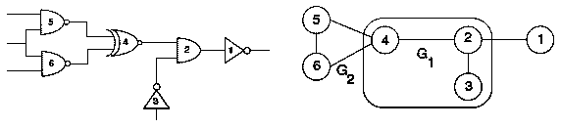
KL Algorithm Walkthrough – 1
2
1
3
5
4
6

Slide 29
KL Algorithm Walkthrough – 2
1-0 = 1
1-2 = -1
0-1 = -1
2-1 = 1
1-1 = 0
1-1 = 0
-1 + 1 – 2 = -2
-1 + 0 – 0 = -1
-1 + 0 – 0 = -1
-1 + 1 – 0 = 0
-1 + 0 – 0 = -1
-1 + 0 – 0 = -1
1 + 1 – 0 = 2
1 + 0 – 2 = -1
1 + 0 – 2 = -1
D₁ =
D₂ =
D₃ =
D₄ =
D₅ =
D₆ =
gain(2, 1) =
gain(2, 5) =
gain(2, 6) =
gain(3, 1) =
gain(3, 5) =
gain(3, 6) =
gain(4, 1) =
gain(4, 5) =
gain(4, 6) =
2
1
1
3
5
4
4
6
g₁

Slide 30
KL Algorithm Walkthrough – 3
1 – 2 = -1
0 – 1 = -1
0 – 2 = -2
0 – 2 = -2
-1 + -2 – 0 = -3
-1 + -2 – 0 = -3
-1 + -2 – 0 = -3
-1 + -2 – 0 = -3
D₂ =
D₃ =
D₅ =
D₆ =
gain(2, 5) =
gain(2, 6) =
gain(3, 5) =
gain(3, 6) =
2
4
2
g₂
3
5
5
1
6

Slide 31
KL Algorithm Walkthrough – 4
D₃ =
D₆ =
gain(3, 6) =
1 – 0 = 1
1 – 1 = 0
1 – 0 – 0 = 1
g₃
5
4
g₁ = 2, g₂ = -3, g₃ = 1
Then ???
We need to find k
k = 1: g₁ =
k = 2: g₁ + g₂ =
k = 3: g₁ + g₂ + g₃ =
2
-1
0
3
3
2
5
4
1
6
6
6
2
1
3

Slide 32
KL Algorithm Walkthrough – 5
Since k = 1, we only take 1 move → swap (4, 1)
Finally, we get the result? NO! We only go 1 iteration!
Move on to the next iteration until converged
2
1
2
4
3
5
3
5
4
6
1
6

Slide 33
Recap: KL Algorithm
Start with any initial legal partitions X and Y
A pass (exchanging each vertex exactly once) is as follows:
1. For i := 1 to n do
From the unlocked (unexchanged) vertices,
choose a pair (A,B) s.t. gain(A,B) is largest (greedy)
Exchange and Lock A, B
Let g_{i} = gain(A,B)
2. Find the k s.t. G=g₁+...+g_{k} is maximized
3. Switch the first k pairs
Repeat the pass until there is no improvement (G=0)
A pass

Slide 34
Time Complexity of KL Algorithm
For each pass of KL
O(n²) time to find the best pair to exchange
n pairs exchanged
Total time is O(n³) per pass
Better implementation can get O(n²log n) time per pass
But requires fairly sophisticated data structure representation
Number of passes is usually small
Converged very fast in practice

Slide 35
Drawbacks of KL Algorithm
Handle only unit vertex weights
Vertex weights might represent block sizes, different from blocks to blocks in real situation
Handle only exact bisection
Need dummy vertices to handle the unbalanced problem
Handle only non-hypergraphs
Practical circuits have many terminal nodes for each cell output
Need to handle multi-terminal nets directly
B
A
A has two terminals, B and C!
C
D

Slide 36
Summary of KL Algorithm
1. Pair-wise exchange of nodes to reduce cut size
2. Allow cut size to increase temporarily within a pass
3. Compute the gain of a swap
Repeat
Perform a feasible swap of max gain
Mark swapped nodes “locked”
Update swap gains
Until no feasible swap
4. Find max prefix partial sum in gain sequence g₁, g₂, …, g_{m}
5. Make corresponding swaps permanent
6. Start another pass if current pass reduces the cut size
u •
v •
v •
u •
locked

